Slide 1


NIEM MILOPS DOMAIN
Issuance Document
Notes:
SPELL CHECK

Slide 2
Outline
Purpose / Bottom Line Up Front
Course of Actions
Proposed Recommendations

Slide 3
Purpose / bluf
As NIEM transitions to OASIS, the MILOPS Military Operation Mission Specific (MOMS) release & content won’t be under NIEMOpen due to its restricted content. In order to codify Military Operations Domain an authoritative document will benefit DOD.
Currently:
DODI 8320.07 states to consider NIEM for all new XML information exchanges.
NIEM is transitioning to an open standard and MILOPS has restricted content.
There is no document to support or provide procedures on the MILOPS content.
Actual Implementation:
DOD CIO does not enforce the 8320.07 policy and has not implemented a waiver program.
MILOPS restricted content must reside with a DOD repository and cannot be part of the NIEMOpen standard.
Result:
Services, CCMDS, and defense agencies policies simply state they considered NIEM, without any evidence.
NIEM is not being utilized by many DOD organizations.
Lack of formal guidance results in lack of DOD adoption across services and CCMDs.

Slide 4
Proposed Recommendation
Near Term
DODI 8320.07 NIEM First Language
Publish a NIEM MILOPS CJCSI
Includes:
Referencing MOMs (how to access it; how to use it).
MILOPS content utilizing NIEM Open.
Mid Term
Publish CJCSM
Includes:
How to implement NIEMOpen and MOMS.
Long Term
Request change to DISR to add NIEMOpen on the commercial standard list.
Notes:
Near Term:
First work the process to update the DODI.
Then work on writing a CJCSI for MILOPS Domain referencing NIEM Open and MOMS content.
Stating “will use NIEM standards-based approach when developing XML information exchanges.
This will provide more specification / clarification to the DODI.
MILOPS Domain sponsors and manages the CJCSI
JS will continue to have authority over MILOPS Domain.
Annual review after the first 2 years.
Republish after 5 years.
This would be CJCSI #6243.01 which will align with the interoperability CJCSIs 6200 series.
Long Term:

Slide 5
BACK UP
Notes:
Why a CJCIS for MILOPS? How does it benefit NIEM?
How is it aligning with the Organization’s goals?
DODD, DODI, DODM or Directive-type memorandum
in order to inform doctrine and affect real change for MilOps; you probably need a DoDI, a CJCSI and a CJCSM. A DoDI mandates NIEM, A CJSCI tasks the services and a CJCSM will show how to implement. The bottom line question is who is the target audience. The DODI states to consider NIEM. Mentions in the FMN spiral.

Slide 6
Course of actions
Update DODI 8320.07 to reflect NIEM first language.
Publish a DODI that establishes policy for NIEM as a standard.
Publish a DODM that supplements the DODI and provides guidance on implementation of NIEM as a standard.
Request a change in the DISR to add NIEMOpen on the list of the commercial standards that DOD has to use first.
Publish NIEM MILOPS CJCSI
Establish policy on NIEM MILOPS and codify MILOPS content
Provides brief guidance on how to implement MILOPS content using NIEMOpen.
Publish NIEM MILOPS CJCSM
Establish policy on NIEM MILOPS and codify MILOPS content
Provide detailed guidance on how to implement MILOPS content using NIEMOpen.
Publish MIL-STD NIEM MILOPS
Establish and clarify military specific requirement based on MILOPS content using/referencing NIEMOpen.

Slide 7
Research / Analysis of different types of documents
DODI | DODM | CJCSI | CJCSM | MIL-STD
Establishes DOD Policy | Establishes Procedures | Establishes JS Policy | Establishes Procedures | Establishes Procedures
Currently for NIEM DODI 8320.07 requires a waiver process. | Supplements the DODI 8320.07 – used to enforce and establish waiver procedures from the DODI. | Clarifies National & DOD Policy | Clarifies National & DOD Policy | Clarifies Military Unique / Military specific requirement
Governs & Regulates activities & missions across the defense enterprise | Requires to update the DODI 8320.07 to reference DODM | Establishes guidance to Services, CCMDs, defense agencies. | Establishes guidance to Services, CCMDs, defense agencies. | Defines consistent procedures on how to conduct technical or technical management functions.
JS J6 DSD ghost writes them & coordinates with OSD | JS J6 DSD ghost writes them & coordinates with OSD | Aligns with Interoperability 6200 series CJCSIs
Notes:
The Chairman uses Instructions, Notices, Manuals and Guides -- collectively called "directives" -- to clarify National and DOD policy and provide guidance to the Services, combatant commands, and defense agencies in accomplishing certain missions. Chairman's instructions, manuals, and notices convey CJCS policy that does not contain joint doctrine or concern employment of the forces in joint operations.
For MIL_STD: in regards to commercial products, it is recommended to first consider using or developing a non-Government standard or including DOD-requirements in an existing non-Government standard. If that will not meet the need, consider developing or revising a commercial item description.

Slide 8
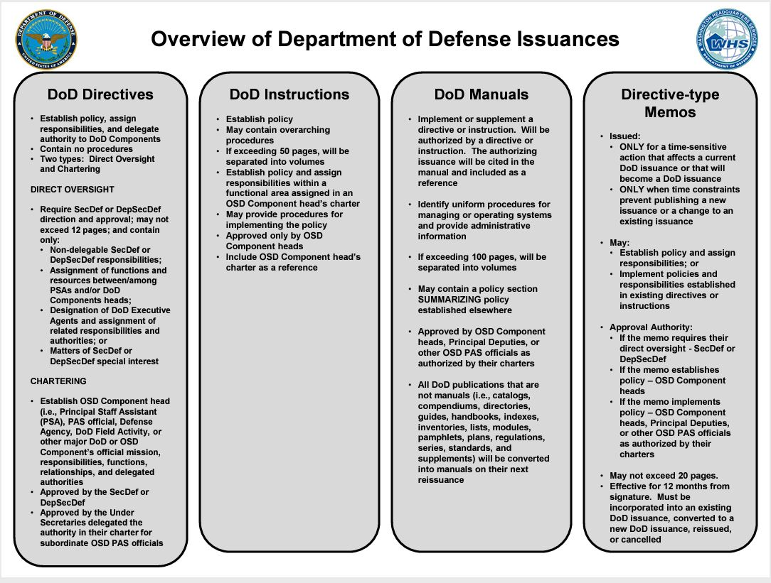

Slide 9
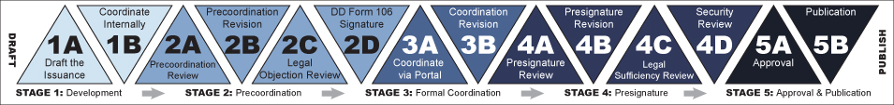
DOD Issuance Process

Slide 10
Overview of CJCS Directives
Instructions - Primarily contain CJCS/JS policy but can also include procedures. They may implement or supplement DoD Issuances, and/or establish and prescribe JS Forms. Signature level depends on subject matter and current practice.
Manuals – Primarily contain CJCS/JS procedure but can also establish policy. May supplement CJCS/JS instructions or stand alone. Signature level depends on subject matter and current practice.
Notices – Primarily contain policy, guidance, or information of a one-time or brief nature, and may include a specific effective period. Signature level depends on subject matter and current practice. In addition, there are also -
Cancellation Notices, which are used to cancel CJCS/JS Instructions, Manuals, Notices, and Guides, and expire 1 year after being published and;
Change Notices, which are used to employ small changes to CJCS/JS Directives.
Guides – Primarily contain detailed information, emphasis, and guidance from the Chairman on a specific topic, and carry a CJCS-level signature as well.
Notes:
Joint Doctrine – Does not establish policy

Slide 11
Benefits
Marketing purposes
Easier to reference NIEM in collaborations with other organizations and events.
JADC2 Standard View-2
Able to reference NIEM Open as one of the standards by backing up with a CJCSI as the source/authority
Promote adoption within the services and combatant commands.
Notes:
Bold Quest – CJCSI provides more authority for NIEM to be demonstrated in BQ.

Slide 12
Why not a DODI?
Mandates NIEM
Establish policy
Approved by OSD component head
Need OSD sponsorship
Have to coordinate with DA&OP OCMO (the DOD issuances program)
Need DepSecDef approval

Slide 13
Issues
DODI 8320.07, CJCSI 6610.01F, “consider NIEM”
Not referenced in DODI 8110.01
NIEM is referenced in many different documents as consider but it’s not authoritative or enforced.
DOD CIO does not enforce NIEM.
NIEM is referenced in JADC2 Standard V-2 but will be with OASIS as the authority and managed by NTAC.
Notes:
NIEM gets mentioned in many different documents and referenced as “consider first” per the DODI policy which CIO does not enforce.
Writing a DODI for NIEM where we could say that organizations “will use NIEM first” would continue to be managed by CIO so we are trusting that they would manage this policy. We could rewrite DODI 8320.07 but we will be dealing with CIO and again relying on them to enforce it.
Writing a CJCSI is easier in regards to the process since its internal to our organization and we (CJCS) have authority of these types of documents. With the transition to OASIS, CIO will no longer be the executive agent. With this document we (J6) continue to have some control over NIEM and MILOPS domain can manage this document since J6 will be the lead for MILOPS Domain. This CJCSI also ensures that MILOPS Domain will continue to be a DOD entity or a JS entity.
CJCSI 6610.01F – Tactical Data Link Standardization and Interoperability ( consider NIEM)
DODI 8110.01 - Mission Partner Environment Information Sharing Capability Implementation For the DOD
JP 6-0 – Joint Communications System – States that “DOD must adopt a DOD-wide sustainable business model for information sharing that supports the DOD data strategy. This adoption requires organizations to first consider NIEM for their information sharing solutions….”

Slide 14
Purpose
Purpose:
In order to codify Military Operations Domain within NIEM we believe a CJCSI will help the domain to be better utilized by the services and Combatants Commands. MilOps won’t be under NIEM Open
Bottom Line Up Front:
Currently
DODI 8320.07 states to consider NIEM for all new XML information exchanges.
Actual Implementation
DOD CIO never implemented the waiver program.
DOD CIO does not enforce this policy.
Result
Services, CCMDS, agencies simply state they considered NIEM, without
any evidence. NIEM is not being utilized by many DOD organizations.
Proposed Solution
Establish a CJCSI for NIEM Open sponsored and managed by
MILOPS Domain

Slide 15
Recommendations
Update DODI 8320.07 –
Develop a CJCSI –
Notes:
We can’t develop a military standards because MOMs is content that utilizes any different standard. For ex. We can use STANAG as a standard and put MOMs content on it.
NIEM is an open standard, commercial standard.
To write a DODI, we would need OSD to sponsor and DepSecDef or SecDef will need to approve.
To update the DODI 8320.07 we will need to collaborate again with CIO.
To develop a CJCSI, we (MILOPS Domain) will be able to sponsor this and manage it. We (JS) will have better control over the MILOPS content as NIEM will transition to OASIS standard. The process on developing this will be internal (JSAP).
We can develop a CJCSM later as we continue to evolve MILOPS Domain.

Slide 16
PURPOSE
As NIEM transitions to OASIS, the MILOPS Military Operations Mission Specific release & content won’t be under NIEMOpen due to its restricted content. In order to codify Military Operations Domain an authoritative document will benefit DOD.

